Slide 1
PAPER TO PORTAL
Ottawa Carleton assembly of school councils

Slide 2
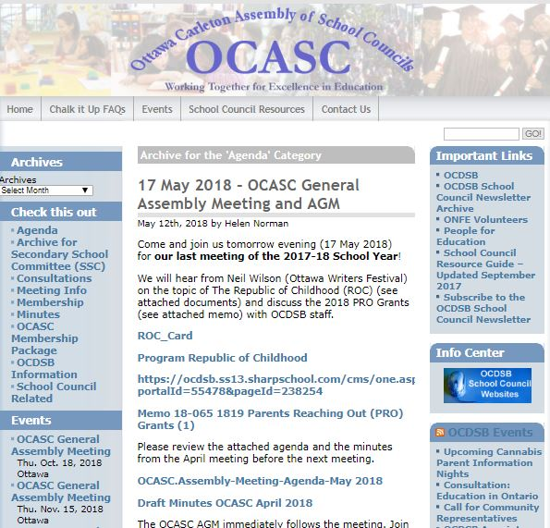
Problem
Knowledge is shared and communicated mostly in face to face meetings, physical documents, and PDFs
Barriers to participation
Difficulty sharing information within school council
Hard to spread knowledge to other councils in Ottawa
Goal: Easy and widespread access to council resources

Slide 3

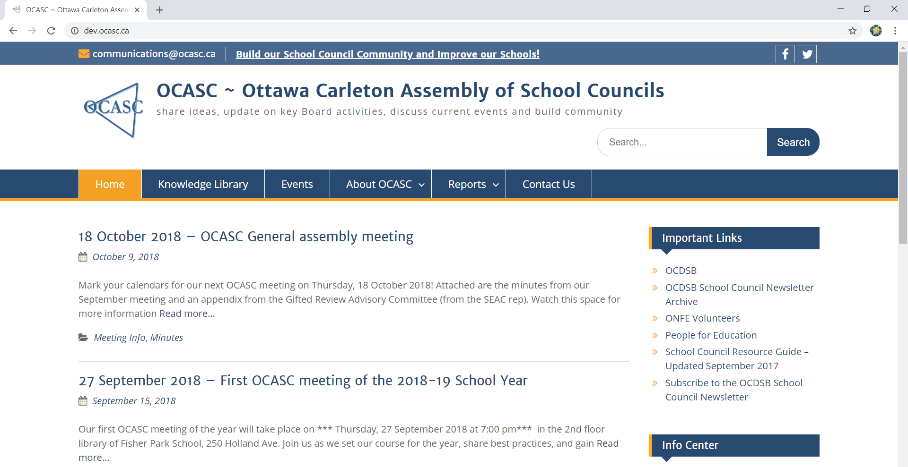
Solution
Product: Knowledge library that allow users to add, edit, search, and retrieve records
Content
Work from existing documents to create a template
Front-end
Turn template into set of online forms
Backend
Connect front-end to database

Slide 4
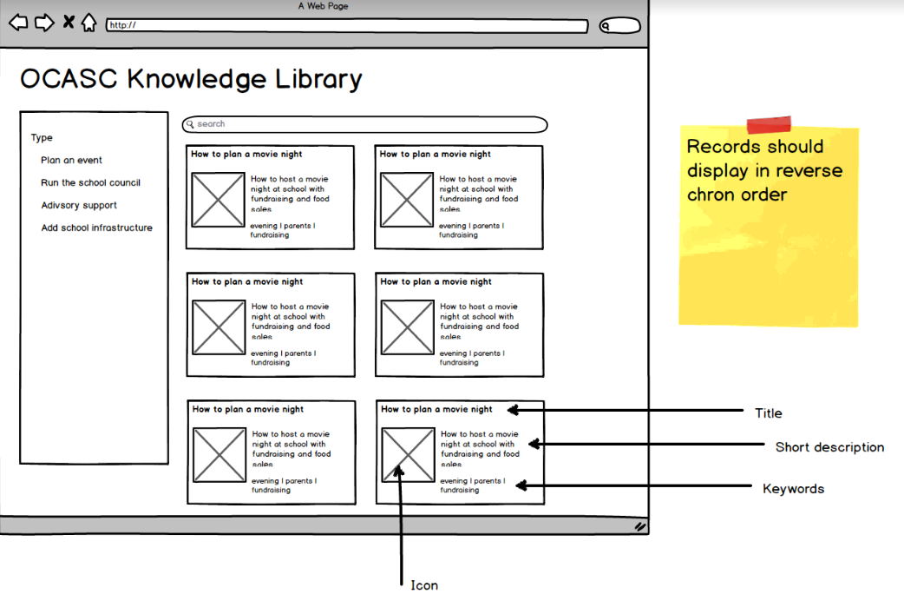
Content
Content inventory
Defined elements for inventory (types, keywords)
Balsamiq to create wireframes
Content style consistency

Slide 5
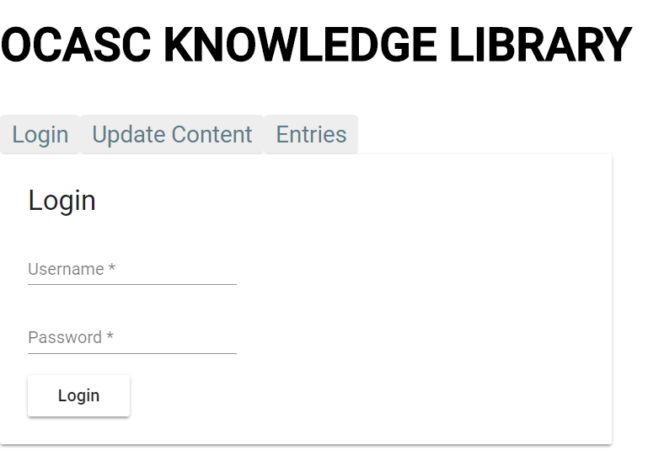
Front-end
Online forms based on content
Web layout

Slide 6
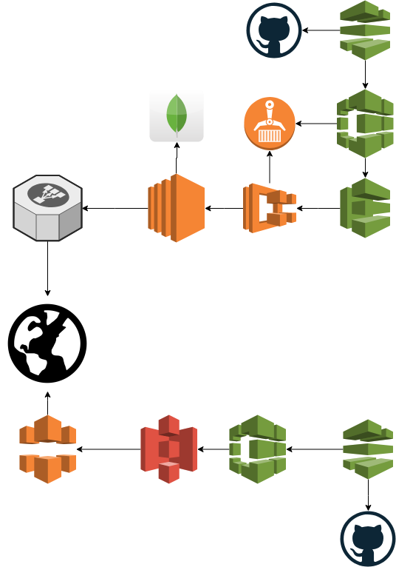
Backend
Rest API
Database
Authentication
Data validation

